Slide 1
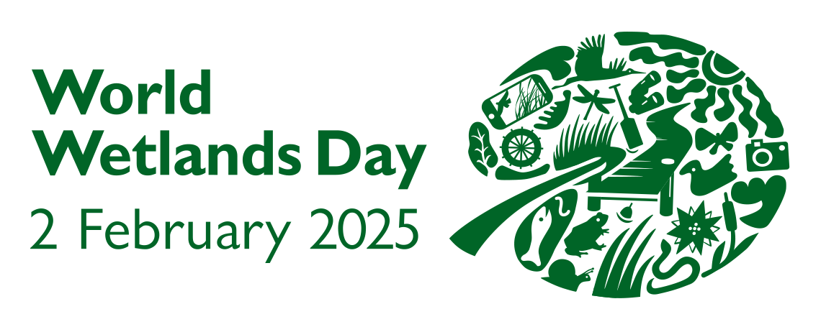
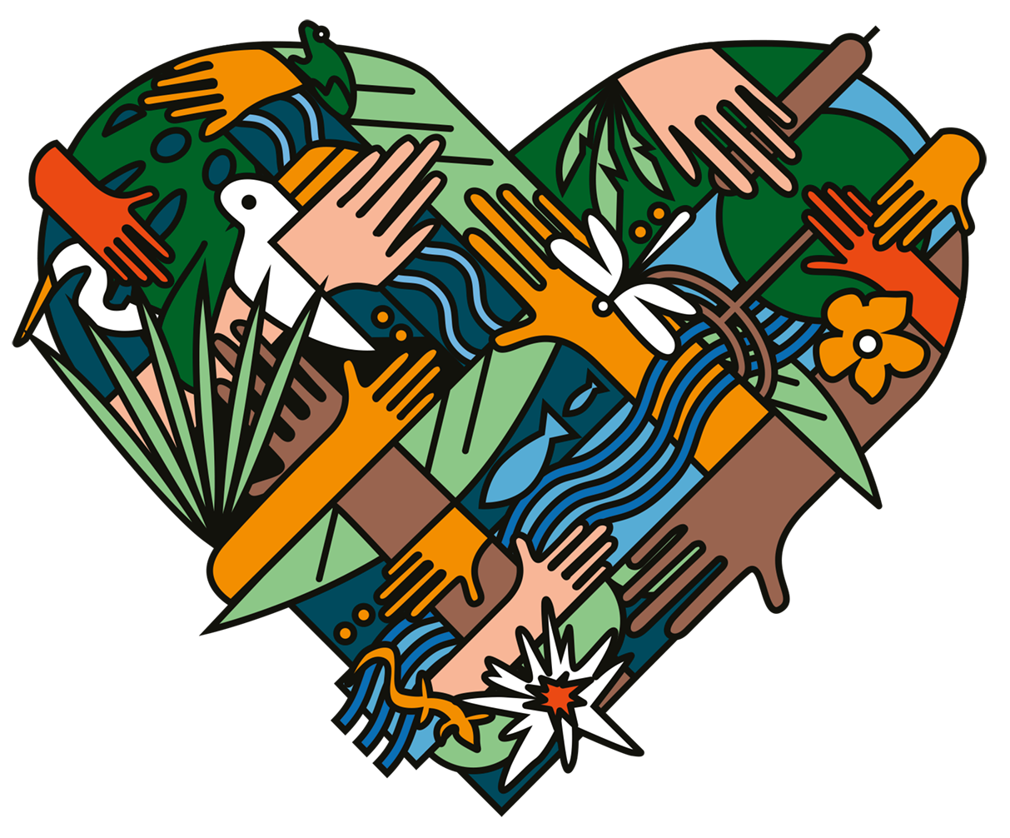
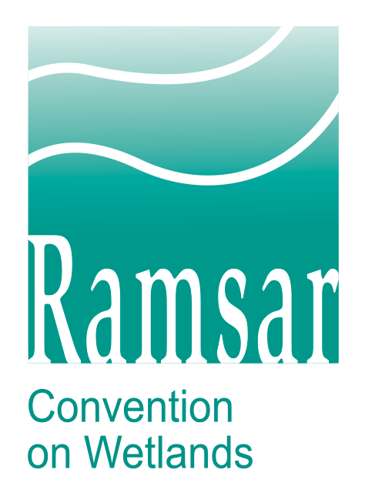
Protecting wetlands for our common future
Value. Protect. Inspire.

Slide 2
World Wetlands Day
Shining the spotlight on a highly productive and threatened ecosystem.
Global awareness campaign.
Calls on nations – and everyone everywhere – to protect our planet’s wetlands.
Reminds us: Healthy wetlands are essential for our universal wellbeing and long-term survival.
Every 2 February since 1997.
Anniversary of the Convention on Wetlands.
Adopted as an international treaty in 1971 in Ramsar, Iran, along the shores of the Caspian Sea.
World’s first modern global multilateral environmental agreement.
Only one devoted to a specific ecosystem – wetlands.
Today, 172 countries are in its membership (Contracting Parties).
Each is committed to the conservation and wise, sustainable use of wetlands in their countries.
A United Nations International Day since 2022.
Aligned with the UN Decade on Ecosystem Restoration, which calls for the protection and revival of ecosystems around the world (2021-2030).

Slide 3
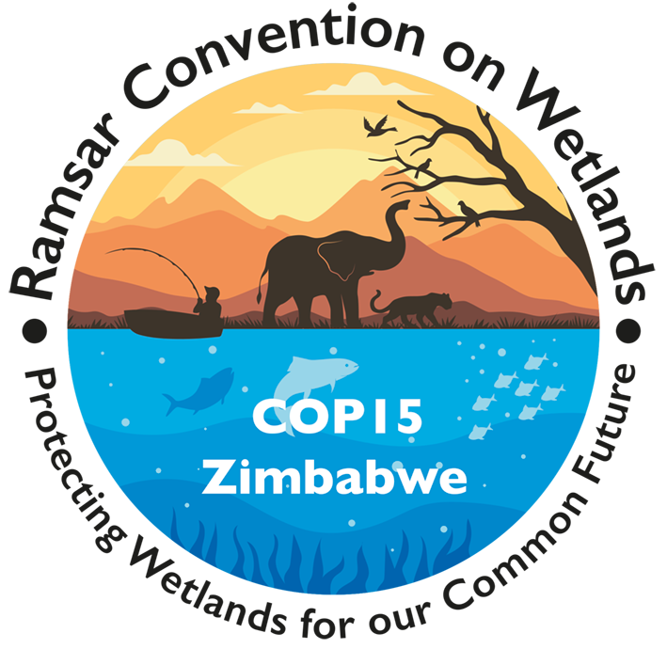
15th Meeting of the Conference of the Contracting Parties to the Convention on Wetlands (COP15)
Leveraging a global opportunity.
Conference takes place every three years.
Government representatives from each of the 172 Contracting Parties meet to facilitate crucial discussions on the conservation and sustainable use of wetlands, foster international collaboration, and agree on a work program for the next three years.
Scheduled for 23-31 July 2025 in Victoria Falls, Zimbabwe.
The Republic of Zimbabwe, Ministry of Environment, Climate, Tourism and Hospitality Industry is the key partner for both COP15 and World Wetlands Day 2025 (WWD2025).
Serves as a platform to promote the conservation of wetlands and spotlight their value.

Slide 4
Theme for WWD2025 and COP15
Joining together to ensure a sustainable future.
Protecting Wetlands for Our Common Future.
Theme for both WWD2025 and COP15.
Underscores the need for collaboration and foresight.
Overriding message:
By valuing and protecting these richly biodiverse, productive ecosystems – and inspiring action on their behalf – together, we can safeguard our common future and wellbeing.
WWD2025 graphic represents people from around the globe joining together in our love for our planet’s wetlands and in our commitment to protect them.
Colors reflect the Zimbabwe flag, as Victoria Falls, Zimbabwe, is the global conservation arena for COP15.

Slide 5
Key objectives
Focusing our combined efforts.
The campaign aims to:
Raise awareness of the vital role of wetlands in environmental sustainability and human survival among the public, policymakers and stakeholders.
Highlight the challenges wetlands face.
Inspire action on wetland conservation and restoration projects by governments, organizations and individuals – nationally and internationally.
Promote the integration of wetland conservation into broader environmental and development agendas.
Showcase success stories of wetland conservation and restoration projects from around the world.
Share best practices and innovative approaches to wetland management.
Increase partnerships and investment in wetlands conservation.
Hashtags: #WWD2025 – #WetlandsCOP15 – #WetlandsForOurCommonFuture

Slide 6
Wetlands: A precious and essential ecosystem
Teeming with life, service and value for all of society.
Make our existence on Earth possible.
Highly interconnected and biodiverse.
Link mountains to oceans, span national borders, connect different habitats and facilitate the movement of species.
Water is the primary factor controlling the environment and plant and animal life.
Cover >12.1 million square kilometers worldwide, ~6% of the Earth’s land surface.
May be saltwater or freshwater, inland or coastal, natural or human-made, permanent or temporary, static or flowing.
Freshwater wetlands: rivers, lakes, pools, flood plains, peatlands, marshes and swamps.
Saltwater wetlands: estuaries, mudflats, saltwater marshes, mangroves, lagoons, coral reefs and shellfish reefs.
Human-made wetlands: Fishponds, rice paddies, reservoirs and saltpans.

Slide 7
“Wherever land meets water, life abounds. Wetlands exist in every corner of this beautiful planet and have often been referred to as the arteries and veins of the Earth. Majestic and mighty, wetlands are a sight to behold.”
— Dr. Musonda Mumba, Secretary General of the Convention on Wetlands

Slide 8
Why wetlands matter

Slide 9
Human societies have an essential and fundamental relationship to wetlands. The earliest city-based civilizations were located in the great floodplains of North Africa, Eurasia, the Andes and Meso-America – testament to the importance of wetlands for humankind.

Slide 10
Sustenance
Providing freshwater and food for eons.
Supply almost all our freshwater.
Their silt-rich soil and plants naturally filter and store water.
Known as Earth’s kidneys.
More than half of the world relies on wetland-grown produce for their staple diet.
Fish from wetlands are the primary source of protein for >1 billion people worldwide.
Rice paddies feed 3.5 billion people annually.
Irrigation is particularly important in regions where rainfall is limited or irregular.
Aquaculture is the fastest growing food production sector.
Water, the bloodstream of the biosphere, which sustains ecosystems and people, is made available by wetlands.

Slide 11
Biodiversity
Supporting an intricate tapestry of life.
Life on Earth depends on wetlands.
Their biodiversity provides food, clean water, medicines and jobs.
40% of all known plant and animal species live or breed in wetlands.
This includes many endangered, threatened and endemic species that can only survive in certain wetland habitats – and nowhere else.
~12% of all visible species (no microscope needed to see) rely on freshwater wetlands.
>1/3 vertebrates, almost all amphibians and half of fishes.
Link different habitats, facilitate the movement of species, help maintain genetic diversity and contribute to climatic and hydrological global processes.
Migratory birds, fishes and other animals depend on wetlands as resting places, feeding areas or breeding grounds during their journeys.
Biodiversity helps protect against disease by ensuring healthy ecosystems and safe spaces for wildlife away from human habitats.
Supply medicinal products.

Slide 12
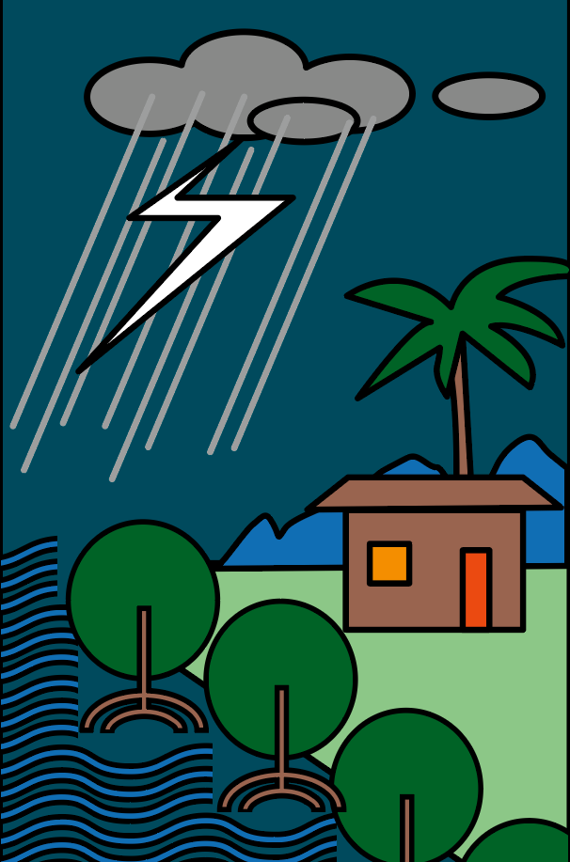
Climate change and natural disasters
Empowering resilience and mitigating the impacts of climate change and extreme weather events.
Key component of Earth’s climate system.
Their services make the environment more resilient and adaptable to climate change and help stabilize the climate.
Crucial for water security.
Store more carbon than any other ecosystem.
Help protect against storm surges, floods and droughts.
>90% of natural disasters are water-related.
Their natural water infrastructure helps reduce floods and delay and relieve droughts.
Each acre of inland wetlands absorbs up to 1.5 million gallons of floodwater.
Services of healthy wetlands reduce humanitarian impacts of natural disasters.
Enhance immediate coping capacities of communities and their sustainable long-term recovery.

Slide 13
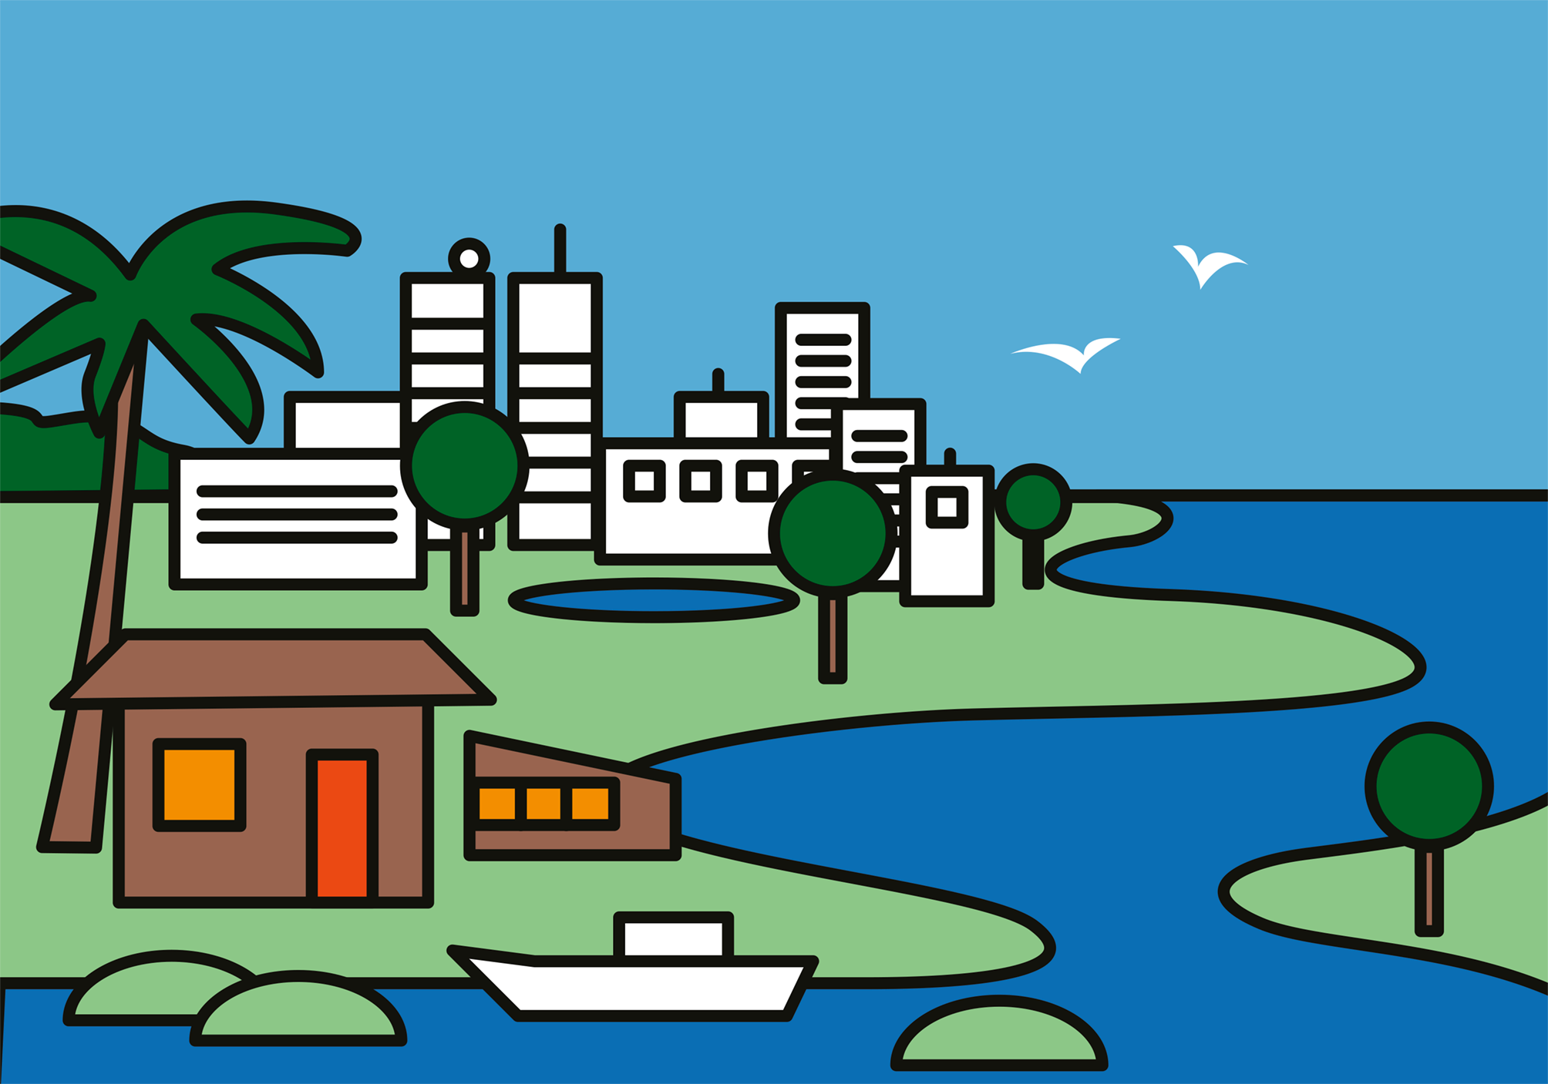
Economies
Providing economic benefits.
Contribute to local and national economies.
Support livelihoods through fisheries, agriculture, tourism and recreation.
1 billion people worldwide (~1 in 8) make their livelihoods from wetlands in ways that also deliver food, water supplies, transport and leisure.
Rice farming is the primary source of wetlands employment.
~80% of the world’s rice is produced by small-scale farmers.
>660 million people depend on fishing and aquaculture for a living.
Travel and tourism sectors support 266 million jobs – 8.9% of the world’s total employment.

Slide 14
Culture and recreation
Connecting people with nature.
Hold significant cultural and recreational value for many communities.
Often tied to long-standing cultural practices that use nature in a sustainable way, enabling human societies to thrive.
Nearly all Wetlands of International Importance (Ramsar Sites) provide cultural ecosystem services.
>50% have spiritual and inspirational value.
People are at the heart of wetland conservation.

Slide 15
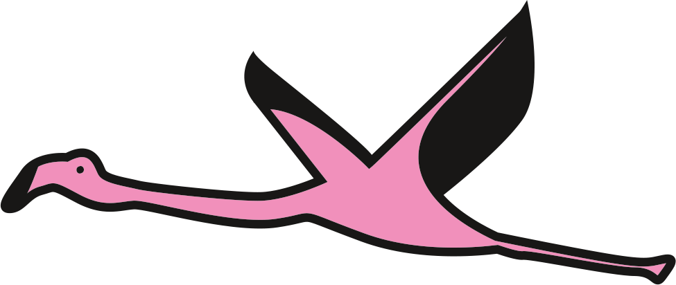
Under threat
Recognizing the urgency.
Among the most threatened ecosystems.
>85% of all wetlands have been lost since 1700s.
At least 35% lost since 1970 with rate of loss accelerating.
Rate of loss is 3X faster than forests.
Risk factors include unsustainable development, pollution, climate change, alterations to hydrological regimes, loss of connectivity, invasive species and over-extraction of water, plants, animals and other natural resources.
Infilling and drainage for conversion to agriculture and urban settlements pose significant threats.
Wetland species face risk of extinction.
1 in 3 freshwater species and 25% of all wetland species face extinction from wetland decline.
81% of inland wetland species and 36% of coastal and marine species have declined in the last 50 years.
Freshwater species have seen an 83% decline (on average) since 1970.
~70% of all global freshwater extraction and diversion is for agriculture.

Slide 16
Need for action
Ensuring a resilient, common future.
Healthy wetlands are critical for climate mitigation, adaptation, biodiversity, and human health and wellbeing.
Control of emergent zoonotic diseases depends on well-managed, intact ecosystems and native biodiversity.
Protecting wetlands for our common future requires:
Coordinated efforts at local, national and global levels.
Collaboration on policies, regulations and community initiatives.
Integration and coordination across the agriculture, urban development and wetland management sectors.
You can:
Understand the significance and contributions of wetlands.
Ensure their sustainable use by managing them wisely.
Attract the investments needed to conserve and restore them.

Slide 17
Wetlands Wednesday
Building a movement through social media.
Using the hashtag #WetlandsWednesday, people around the world are sharing to inspire.
Posts include:
Examples of successful wetland conservation projects and other success stories.
Ideas for how people can act for wetlands.
Discussions of how sustainable use of wetlands benefits people and the planet.
Best practices and innovative approaches to wetland management.
Personal stories about wetlands.

Slide 18
Our actions on behalf of wetlands today will shape the tomorrows of generations to come.

Slide 19
Protecting wetlands for our common future
Value. Protect. Inspire.

Slide 20
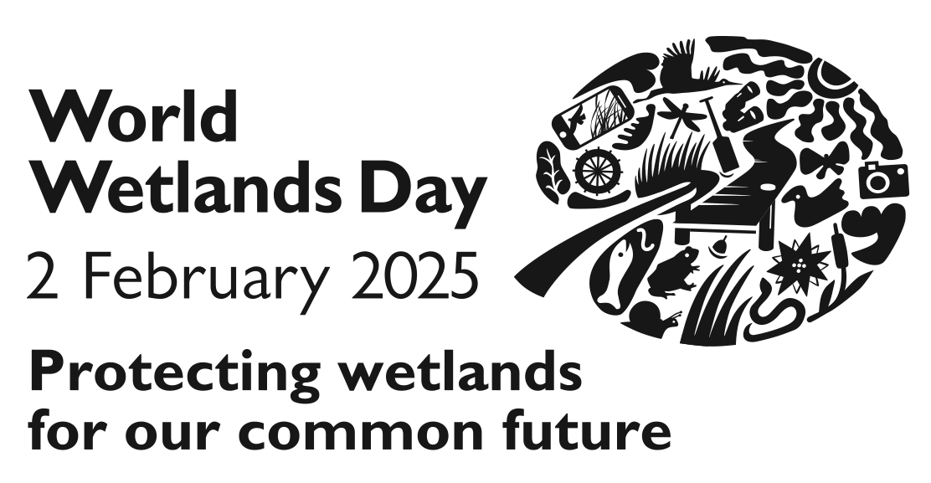
Together we can.
#ActForWetlands

